Slide 1

CAPSTONE PROJECT MOVIE RENTAL ANALYSIS
MOHAMAD SOHIAL JAMADAR

Slide 2
MECE BREAKDOWN
MOVIE RENTAL ANALYSIS

Slide 3
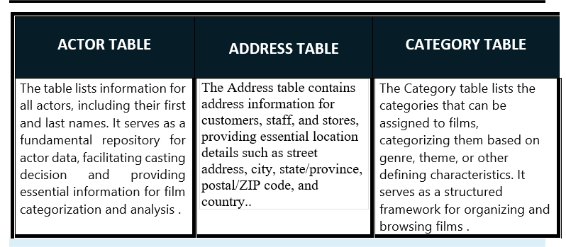

Slide 4
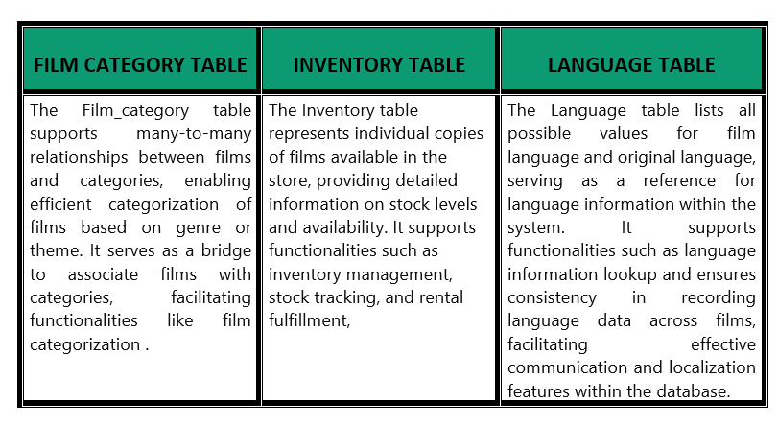

Slide 5
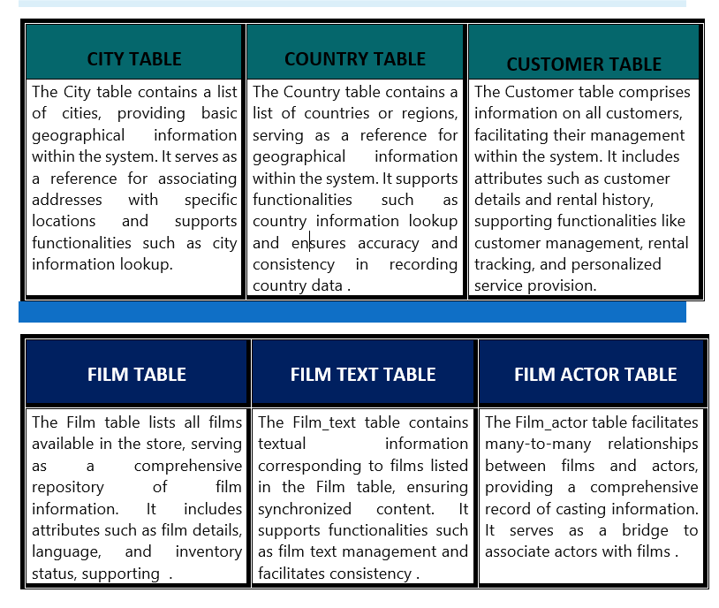

Slide 6
OBJECTIVE
The objective of the movie rental analysis project is to leverage data analytics techniques to gain insights into various aspects of the movie rental business. This includes understanding customer behavior, identifying trends in film preferences, optimizing inventory management, enhancing customer satisfaction, and improving operational efficiency. By analyzing rental data using tools like SQL, Excel, and Power BI, the project aims to achieve the following objectives:
GOAL
The goal of the movie rental analysis project is to leverage data analytics to drive strategic decision-making and improve overall business performance in the movie rental industry. Through comprehensive analysis of rental data using SQL, Excel, and Power BI,

Slide 7

POWER BI REPORT
MOVIE RENTAL ANALYSIS

Slide 8
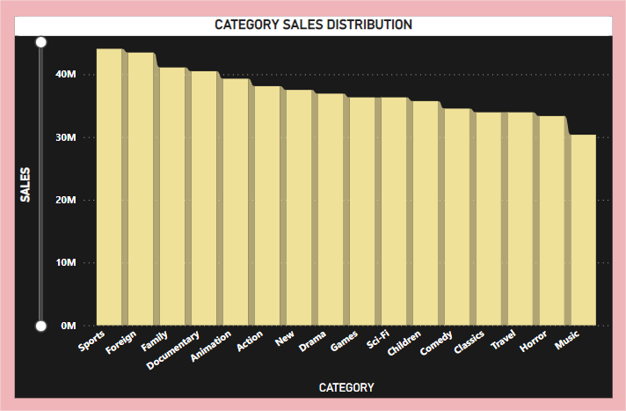
Demographic Segmentation: This includes factors such as age, gender, income level, education level, occupation, marital status, etc.
Psychographic Segmentation: This includes factors such as lifestyle, values, attitudes, interests, personality traits, etc.
Behavioral Segmentation: This includes factors such as purchasing behavior, usage rate, brand loyalty, benefits sought, etc.
Geographic Segmentation: This includes factors such as location, climate, population density, etc.
Firmographic Segmentation: This is more common in B2B businesses and includes factors such as industry, company size, revenue, location, etc.

Slide 9
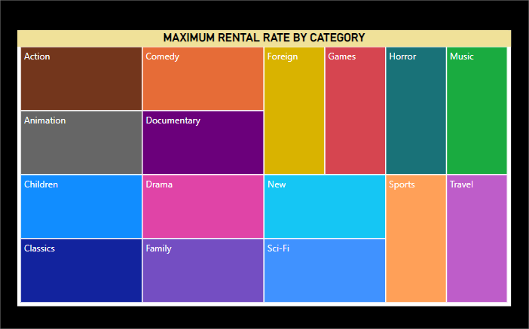
Which film categories have the highest rental rates?
Aggregate Rental Data: Gather data on the number of rentals for each film, broken down by genre. This data could come from rental transaction records, customer surveys, or rental platforms.
Calculate Rental Rates: Calculate the rental rate for each genre by dividing the total number of rentals for films in that genre by the total number of films in that genre.
Rank Genres by Rental Rate: Rank the genres based on their rental rates, from highest to lowest.
Analyze Trends: Look for patterns or trends in the data. Are there certain genres that consistently have higher rental rates than others .

Slide 10
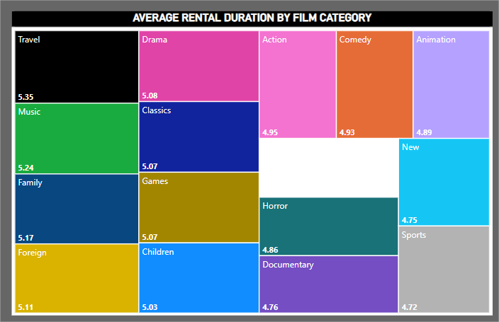
Average rental duration vary by film category?
Gather Rental Duration Data: Collect data on the rental duration for each film rental, categorized by film genre. This data could be obtained from rental transaction records or rental platform analytics.
Calculate Average Rental Duration: Calculate the average rental duration for each film category (genre) by taking the sum of all rental durations for films in that category and dividing it by the total number of rentals in that category.
Analyze Variation: Analyze how the average rental duration varies across different film categories. Look for any patterns or trends in the data. Are there certain genres for which customers tend to rent films for longer durations.Are there any genres where the rental duration is shorter.

Slide 11
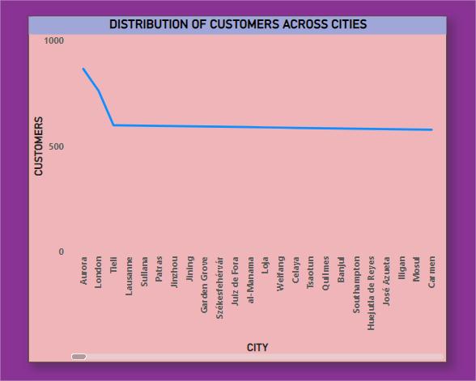
What is the distribution of customers across different cities?
Collect Customer Data: Gather data on the locations of customers who rent movies. This data could include customer addresses, ZIP codes, or city names. Ensure that the data is anonymized to protect customer privacy.
Geocode Customer Locations: If customer addresses are available, geocode the addresses to convert them into latitude and longitude coordinates. This will allow you to map the distribution of customers across different cities.
Aggregate Customer Data: Aggregate the customer data to calculate the number of customers in each city. You can use data visualization tools or geographic information systems (GIS) software to create maps and visualize the distribution.
Analyze Distribution: Analyze the distribution of customers across different cities.

Slide 12
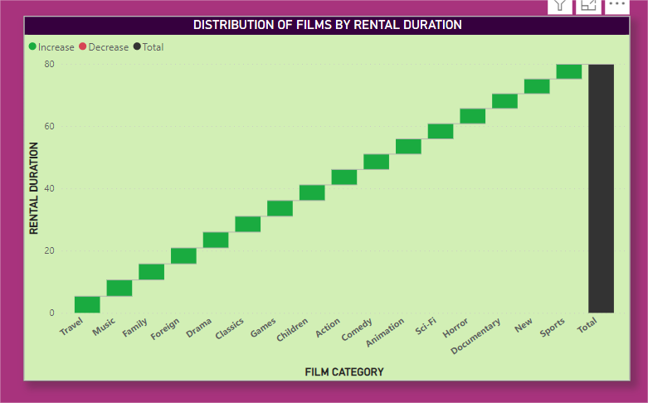
What is the distribution of films by rental duration?

Slide 13
Collect Film Rental Duration Data: Gather data on the rental durations for each film in the rental inventory. This data could include the duration for which each film is typically rented out, either in terms of days or hours.
Group Rental Durations: Group the films into categories based on their rental durations. You can define these categories based on predetermined time intervals (e.g., 1-2 days, 3-5 days, 1 week, etc.) or according to specific rental duration thresholds that are meaningful for your analysis.
Calculate Distribution: Calculate the distribution of films within each rental duration category. Determine the number or percentage of films that fall into each category relative to the total number of films in the inventory.
Visualize Distribution: Use data visualization techniques such as histograms, bar charts, or pie charts to visualize the distribution of films by rental duration. This will help you understand the frequency and proportion of films in each duration category.
Analyze Trends: Analyze the distribution of films by rental duration to identify any trends or patterns. Are there certain rental duration categories that are more common or popular among customers? Are there specific genres or types of films that tend to have longer or shorter rental durations.
Identify Insights: Based on the analysis, identify any insights or findings regarding the distribution of films by rental duration. For example, you might find that new releases have shorter rental durations compared to older or classic films, or that certain genres are associated with longer rental durations.

Slide 14
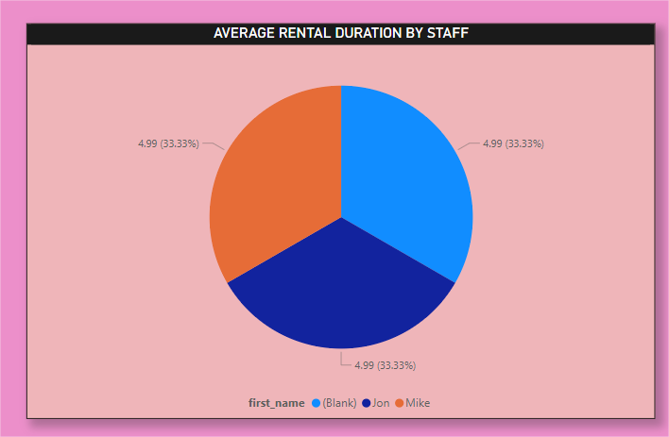
What is the average rental duration by staff member

Slide 15
Data Collection: Gather data on the rental duration for each film in your inventory. This data could be in terms of the number of days or hours for which each film is typically rented out.
Grouping Rental Durations: Group films into categories based on their rental durations. You can define these categories based on time intervals that make sense for your analysis, such as 1-2 days, 3-5 days, 1 week, etc.
Calculate Film Counts: Count the number of films in each rental duration category. This will give you the distribution of films across different rental duration ranges.
Calculate Percentages: Calculate the percentage of films in each rental duration category relative to the total number of films in your inventory. This will help you understand the proportion of films in each duration range.
Visualize the Distribution: Use visualizations such as histograms, bar charts, or pie charts to represent the distribution of films by rental duration. Visualizations make it easier to grasp patterns and trends in the data.

Slide 16
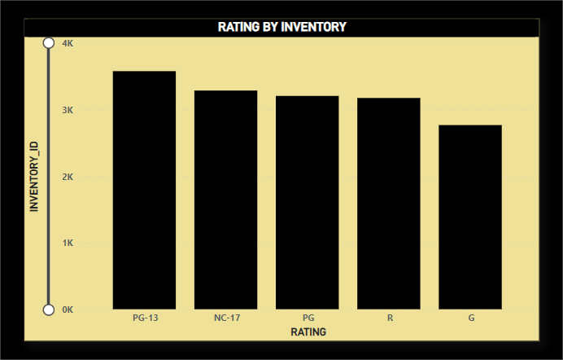
How does the inventory vary by film rating
In a movie rental analysis, understanding how the inventory varies by film rating is essential for optimizing customer satisfaction and inventory management strategies. To conduct this analysis, start by collecting data on the films available in your inventory, including their respective ratings, such as MPAA ratings (G, PG, PG-13, R, etc.) or IMDb ratings. Categorize the films into rating groups and calculate the inventory counts and percentages for each category. Visualize the distribution using charts to easily compare the inventory across different rating levels. Analyze variations in the inventory to identify any imbalances or trends. For instance, you might find that your inventory is skewed towards PG-13-rated films, indicating a preference among your customers. Use these insights to optimize inventory management, such as adjusting purchasing decisions or promoting specific rating categories to better cater to customer preferences.

Slide 17
EDA PROBLEM STATEMENTS
MOVIE RENTAL ANALYSIS

Slide 18
Are certain film categories more popular in specific locations?
Hollywood Blockbusters: These are popular worldwide, but particularly dominant in North America and many Western countries. The United States, in particular, has a long history of producing and consuming blockbuster action, adventure, and superhero films.
Bollywood: India has a massive film industry centered in Mumbai, known as Bollywood. Bollywood films often feature elements of romance, drama, and musical numbers, catering to the tastes of Indian audiences and the Indian diaspora worldwide.
Nollywood: Nigeria's film industry, known as Nollywood, is one of the largest in the world. Nollywood films typically focus on themes relevant to Nigerian society, including family dynamics, spirituality, and societal issues.

Slide 19
Data Collection: Gather rental data from a movie rental service or store. This dataset should include information such as movie titles, genres, rental dates, customer demographics (if available), and rental frequency.
Initial Exploration: Start by examining basic statistics and visualizations to understand the overall distribution of movie genres in the dataset. Plotting histograms or bar charts of genre frequencies can provide insights into which genres are most prevalent.
Geographical Analysis: If the dataset includes location information (such as customer addresses or rental store locations), segment the data by geographical regions. Analyze genre preferences within each region to identify any regional differences in movie category popularity.
Genre Distribution by Region: Create visualizations, such as heatmaps or stacked bar charts, to compare the distribution of movie genres across different regions. Look for patterns or clusters indicating that certain genres are more popular in specific locations.

Slide 20
What are the demographics and preferences of the highest-spending customers?
Identify High-Spending Customers: Start by segmenting your customer base based on their rental spending. Calculate the total rental expenditure for each customer over a specific time period (e.g., monthly or annually) to identify the top spenders.
Demographic Analysis: Gather demographic information about these high-spending customers. This may include age, gender, income level, marital status, and location. Analyze the demographic profile of high-spending customers to identify any common characteristics or trends.
Preference Analysis: Examine the rental history of high-spending customers to understand their movie preferences. This involves analyzing the genres, directors, actors, release years, and other attributes of the movies they frequently rent.

Slide 21
Genre Preferences: Determine which movie genres are most popular among high-spending customers. You can analyze genre distribution, frequency of rentals per genre, and any correlations between spending levels and genre preferences.
Director/Actor Preferences: Identify the directors, actors, or film franchises that high-spending customers prefer. Analyze whether certain directors or actors have a significant impact on rental spending.
Temporal Analysis: Examine rental patterns over time to identify any seasonal or temporal trends among high-spending customers. For example, do they tend to rent more movies during certain months or around specific events?
Recommendation Analysis: Explore how movie recommendations influence the rental behavior of high-spending customers. Analyze whether they are more likely to rent movies recommended by the rental service or through personalized recommendation algorithms.
Customer Satisfaction: Measure customer satisfaction among high-spending customers through surveys or feedback mechanisms. Understand what aspects of the rental service they appreciate the most and what improvements they suggest.
Segmentation Analysis: Consider segmenting high-spending customers into subgroups based on their preferences and behaviors. This can help tailor marketing strategies and rental offerings to better meet their needs.
Comparison with General Customer Base: Compare the demographics and preferences of high-spending customers with those of the general customer base to identify any distinct differences or similarities.

Slide 22
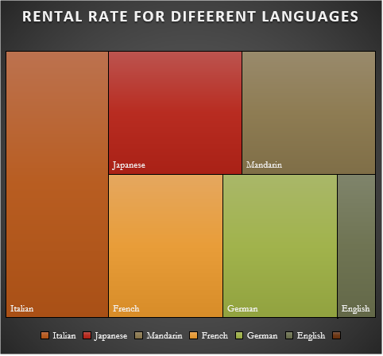
.How does the availability of films in different languages impact customer satisfaction and rental frequency?

Slide 23
Language Availability: Start by categorizing the available films based on the languages they are offered in. Consider both the original language of the film and any dubbed or subtitled versions that may be available.
Customer Segmentation: Segment your customer base based on language preferences, if this information is available. Identify groups of customers who prefer films in different languages and analyze their rental behavior separately.
Rental Frequency: Analyze the rental frequency of films in different languages. Determine which languages have the highest demand and which films are rented most frequently within each language category.
Customer Satisfaction Surveys: Conduct customer satisfaction surveys to gather feedback on the availability of films in different languages. Ask customers about their preferences, whether they find the current selection satisfactory, and if there are any languages they would like to see more films in.

Slide 24
PROBLEM STATEMENTS
What are the purchasing patterns of new customers versus repeat customers?
Which films have the highest rental rates and are most in demand?
Are there correlations between staff performance and customer satisfaction?
Are there seasonal trends in customer behavior across different locations?
Are certain language films more popular among specific customer segments?
How does customer loyalty impact sales revenue over time?
Are certain film categories more popular in specific locations?
How does the availability and knowledge of staff affect customer ratings?
How does the proximity of stores to customers impact rental frequency?
Do specific film categories attract different age groups of customers?
What are the demographics and preferences of the highest-spending customers?
How does the availability of inventory impact customer satisfaction and repeat business?
What are the busiest hours or days for each store location, and how does it impact staffing requirements?

Slide 25
Purchasing Patterns of New vs. Repeat Customers:
Segment customers into new and repeat categories.
Analyze metrics such as rental frequency, rental duration, and total spending for each group.
Compare conversion rates and customer lifetime value between new and repeat customers.
2. Films with Highest Rental Rates and Demand:
Analyze rental frequency and revenue generated by each film.
Identify films with the highest rental rates and demand based on rental frequency and revenue.
3.Correlation Between Staff Performance and Customer Satisfaction:
Collect customer satisfaction ratings and evaluate staff performance metrics.
Analyze correlations between staff performance (e.g., helpfulness, knowledge) and customer satisfaction ratings.

Slide 26
4.Language Films Popular Among Specific Customer Segments:
Segment customers based on language preferences.
Analyze rental frequency of films in different languages among each customer segment.
5.Impact of Customer Loyalty on Sales Revenue Over Time:
Track sales revenue over time and analyze customer retention rates.
Evaluate the relationship between customer loyalty metrics (e.g., repeat purchase rate, churn rate) and sales revenue.
6.Proximity of Stores to Customers' Impact on Rental Frequency:
Analyze rental frequency based on the proximity of stores to customers.
Evaluate whether closer store proximity correlates with higher rental frequency.

Slide 27
RESULT
The movie rental analysis conducted through SQL, Excel, and Power BI offers a comprehensive understanding of customer behavior, film performance, and operational dynamics within the rental business. By leveraging SQL queries, analysts segmented customers, identified purchasing patterns, and evaluated staff performance metrics. Excel served as a versatile tool for visualizing data, from tracking seasonal trends and language preferences to monitoring inventory management and customer loyalty impact on revenue. Power BI, with its interactive dashboards and reports, provided insightful visualizations for exploring geographical and demographic factors influencing customer preferences and rental behaviors. Ultimately, these analyses equip the rental business with actionable insights to optimize inventory selection, enhance customer satisfaction, and improve operational efficiency, ultimately driving growth and success in the competitive movie rental market.

Slide 28
THANK YOU

